Slide 1
EpicSam: BatteriesNotIncluded2
Project plan - Deliverable 2
Haorui Li, Darius Bruno, Kevin Wei, Ilyas Naim

Slide 2
Task breakdown & assignment
Tasks: implement 4 mini simulations that encompass the 4 main topics of the NYA mechanics course: momentum, forces, energy and kinematics.
User story: I want to visually observe the concepts I’ve learned in the mechanics course and see the effects of momentum, forces energy and kinematics in the real world.
To be implemented:
Momentum: a simulation where the user can control objects that collide into each other and be able to observe the energy transfer. Assigned to Haorui
Forces: a simulation where the user can apply forces of various magnitudes and directions on an object and see the net force on it. Assigned to Darius
Projectile motion / kinematics: a simulation where the user can project motion of tiles thrown through the air. Assigned to Kevin.
Energy: a simulation where the user can interact with a test dummy on a skateboard in order to visualize the energy levels. Assigned to Ilyas.

Slide 3
Task breakdown & assignment
Tasks: implement 4 mini simulations that encompass the 4 main topics of the NYA mechanics course: momentum, forces, energy and kinematics.
 | User story | To be implemented | Assigned to | Estimated duration
Momentum | As a physics student, I want to observe how momentum is transferred in collisions, so that I can understand momentum visually. | A simulation where the user can control objects that collide into each other and be able to observe the energy transfer | Haorui | ~9 weeks
Kinematics | As a physics student, I want an interactive kinematics simulation, so that I can understand motion concepts such as displacement, velocity, etc visually. | A simulation where the user can control an object into projectile motion or in 1D motion by changing parameters such velocity, acceleration, etc. | Kevin | ~9 weeks
Energy | As a physics student, I want an interactive energy simulation, so that I can understand energy concepts such as energy transfers visually. | A simulation where the user can interact with a test dummy on a skateboard, as well as different parameters that have an impact on the energy levels, in order to visualize energy transfers. | Ilyas | ~9 weeks
Forces | As a physics student, I want an interactive forces simulation, so that I can understand how different forces affect an object visually. | A simulation where the user can apply various forces to an object and see the results | Darius | ~9 weeks

Slide 4
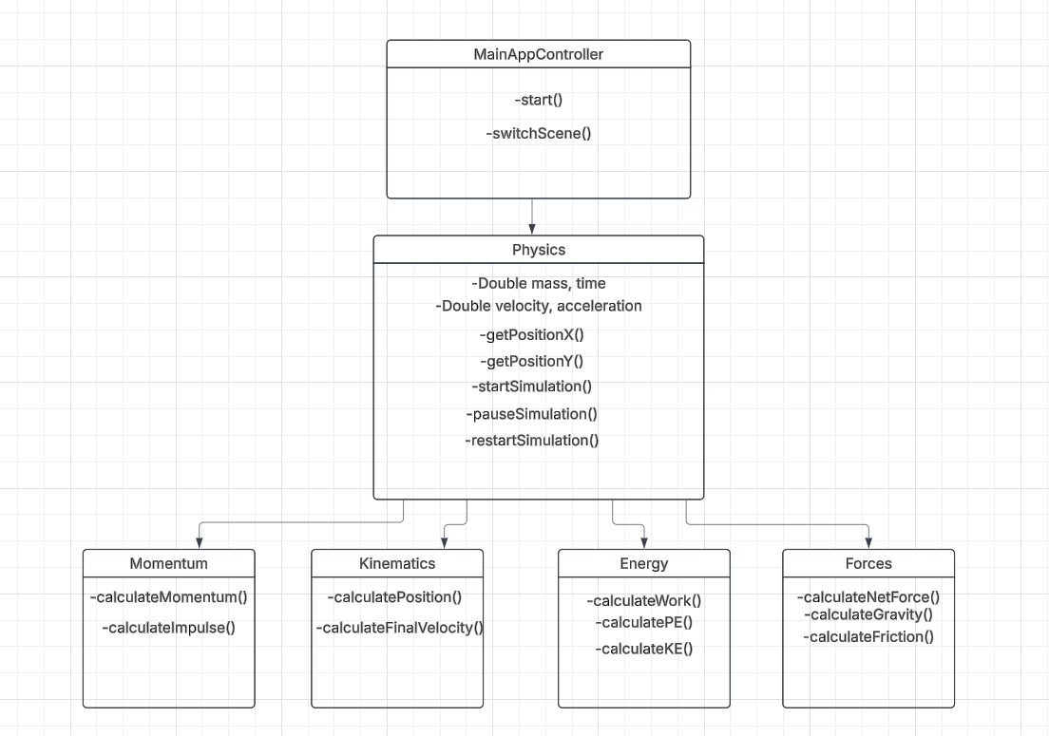
Class diagram

Slide 5
Sample input & output
Momentum:
Input: user chooses the mass and number of balls, sets their angles, velocities and presses play.
Output: the balls get launched and collide, transferring momentum, with the energy transfer, positions, change in velocity all displayed to the user.
Forces:
Input: the user adds a number of force vectors to the diagram and sets their magnitude and direction.
Output: the net force on the object is displayed as a vector along with a force distribution diagram
Projectile motion / kinematics:
Input: the user chooses the mass, initial velocity, gravity, and angle of launch of the ball and presses play
Output: the ball launches through the air and displays the balls trajectory with calculations.
Energy:
Input: User chooses the friction (0-50 N), gravity (0-20 m/s^2), mass (0-100 kg), and function path (mathematically), in order to observe energy levels and transfers. The user can also choose to display the speed and/or the energy pie chart.
Output: Skateboard movement, function path (graphically), speed, time, energy transfers.

Slide 6
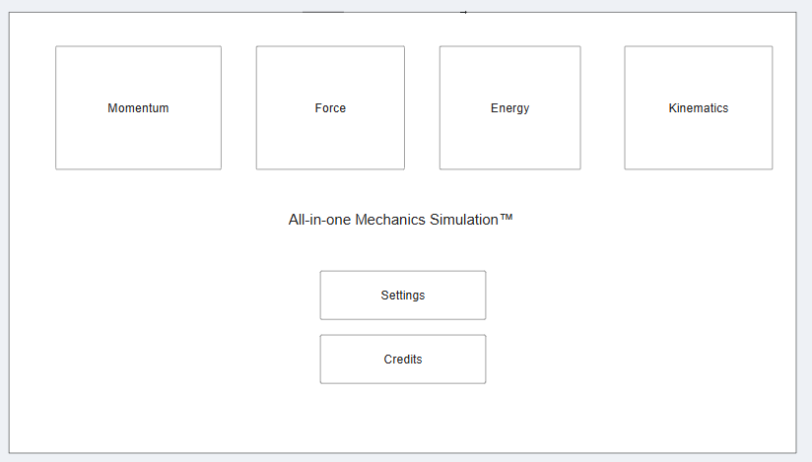
Wireframe
Homescreen

Slide 7
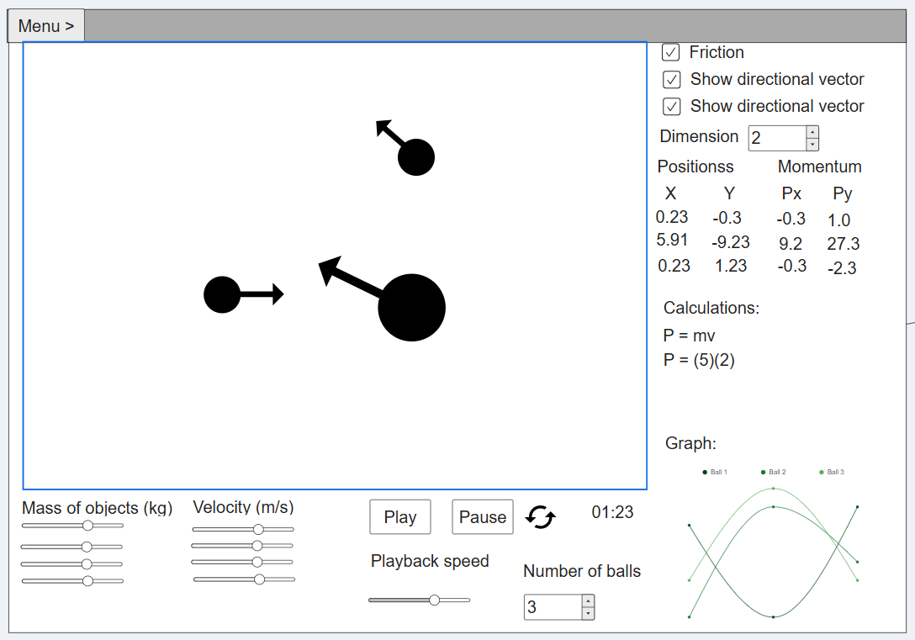
Wireframe (continued)
Momentum simulation

Slide 8
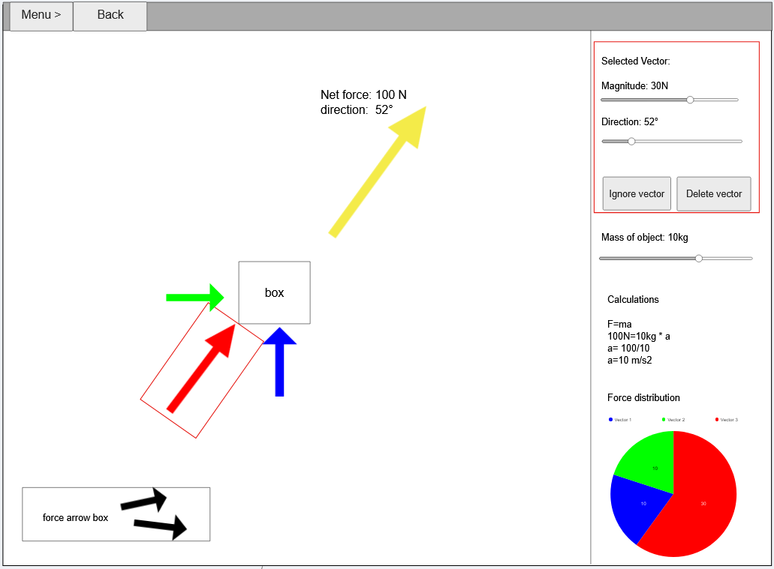
Wireframe (continued)
Forces simulation

Slide 9
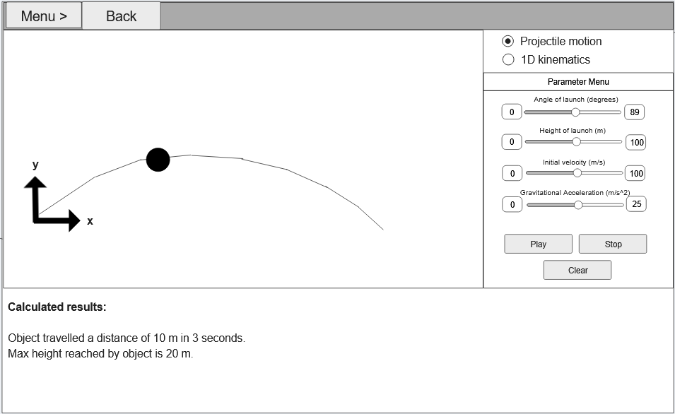
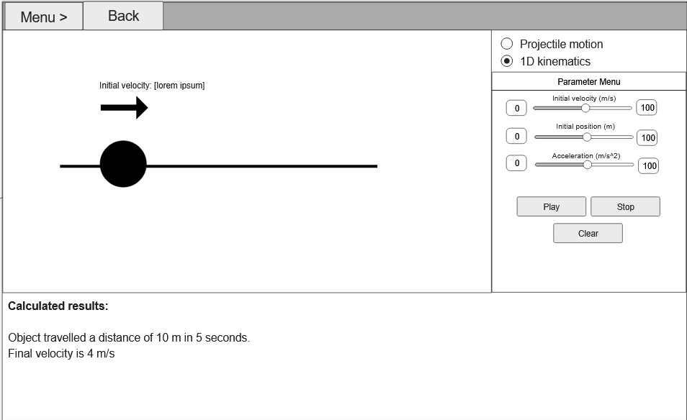
Wireframe (continued)
Kinematics

Slide 10
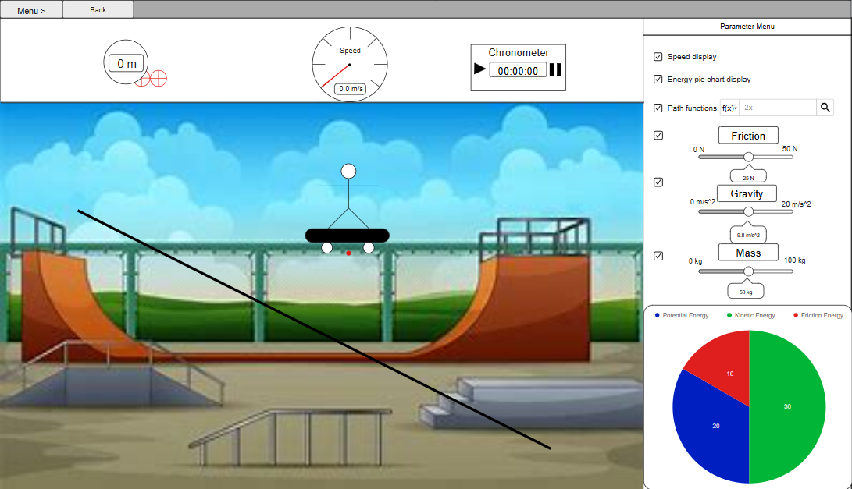
Wireframe (continued)
Energy

Slide 11
Sprint report
Team summary report
Received stories | Resolved stories | Carry over stories | Blocked stories
[W25-8] Decide on what we are doing (1) | [W25-8] Decide on what we are doing (1)
Total points: 1 | Total points: 1 | Total points: | Total points:

Slide 12
Sprint report
Haorui
Received stories | Resolved stories | Carry over stories | Blocked stories
[W25-22] Momentum UI (5) | - | - | -
[W25-11] Momentum animation (8) | - | - | -
[W25-34] Momentum logic (8) | - | - | -
Total points: 21 | Total points: | Total points: | Total points:

Slide 13
Sprint report
Kevin
Received stories | Resolved stories | Carry over stories | Blocked stories
[W25-21] Projectile UI (5)
[W25-28] Kinematics UI (5)
[W25-9] Physics Java class (5)
Total points: 15 | Total points: | Total points: | Total points:

Slide 14
Sprint report
Ilyes
Received stories | Resolved stories | Carry over stories | Blocked stories
[W25-24] Energy UI (5)
[W25-13] Energy animation (8)
[W25-36] Energy logic (8)
Total points: 21 | Total points: | Total points: | Total points:

Slide 15
Sprint report
Darius
Received stories | Resolved stories | Carry over stories | Blocked stories
[W25-12] Forces Animation (8)
[W25-37] Forces logic (8)
[W25-23] Forces UI (5)
Total points: 21 | Total points: | Total points: | Total points:

Slide 16
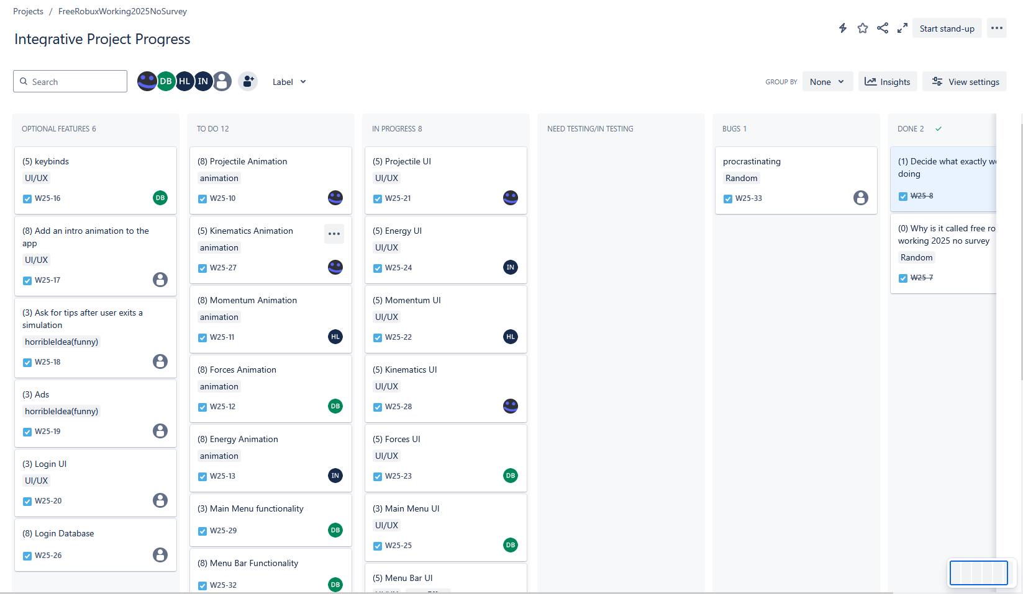
Sprint report
KanBan board part 1

Slide 17
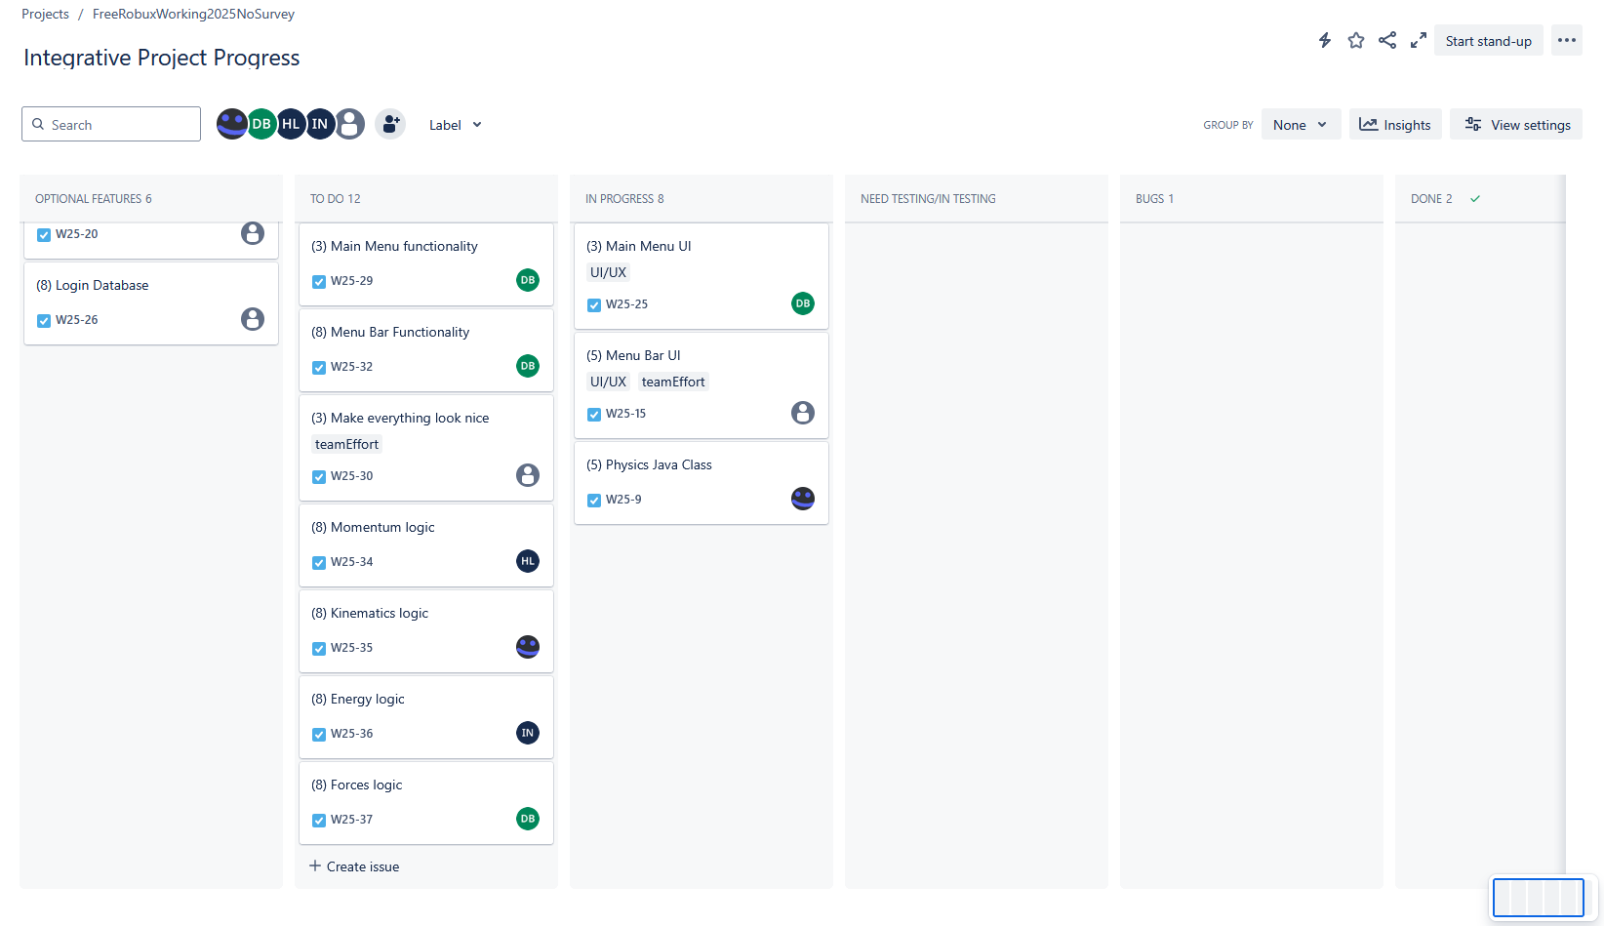
Sprint report
KanBan board part 2

Slide 18
Thank you

